Slide 1
INTRODUCTION TO WEB DEVELOPMENT - SESSION 4
Dragan Gelevski - Gdragan6@gmail.com

Slide 2

Problem solving is a process
@SEDC 2018-2019

Slide 3


THE PROCESS OF PROBLEM SOLVING
Understanding the problem
Devising a plan
Execution of the plan
Looking back
@SEDC 2018-2019

Slide 4
UNDERSTANDING THE PROBLEM
What is the unknown?
What is the data?
What is the condition? Is it possible to satisfy the condition?
Is the condition sufficient to determine the unknown?
Draw a diagram. Introduce suitable notation.
@SEDC 2018-2019

Slide 5
DEVISING A PLAN
Have you seen the problem before? Do you know a related problem?
Look at the unknown. Think of a problem having the same or similar unknown.
Split the problem into smaller sub-problems.
If you can’t solve it, solve a more general version, or a special case, or part of it
@SEDC 2018-2019

Slide 6
EXECUTION OF THE PLAN
Carry out your plan of the solution. Check each step.
Can you see clearly that the step is correct?
Can you prove that it is correct?
@SEDC 2018-2019

Slide 7
EXECUTION OF THE PLAN
Can you check the result?
Can you derive the result differently?
Can you use the result, or the method, for some other problem?
@SEDC 2018-2019

Slide 8
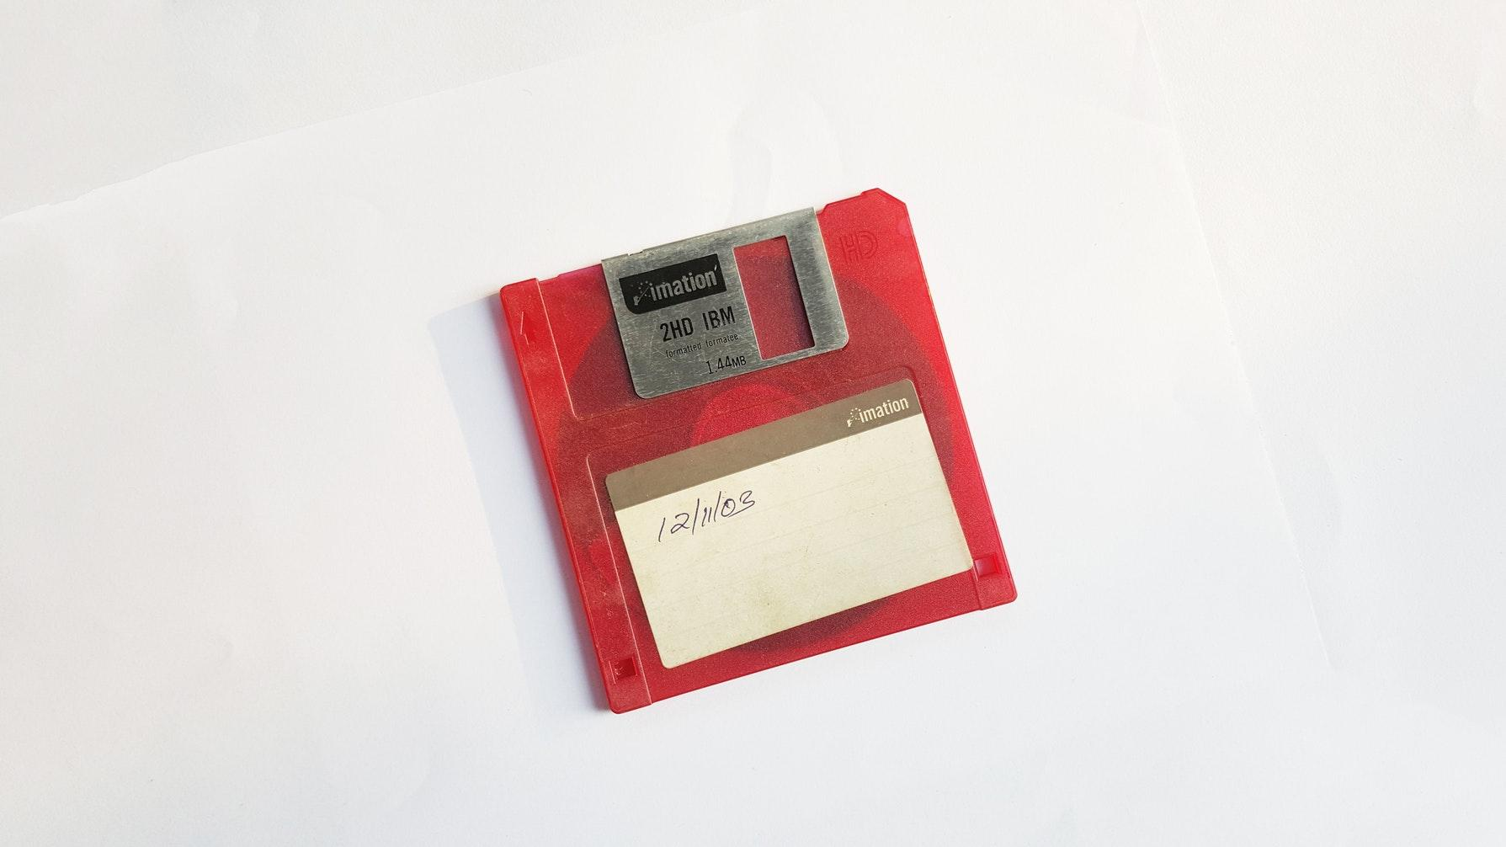
What about building programs?
@SEDC 2018-2019

Slide 9
PHASES OF MAKING A PROGRAM
Clarification/Analysis phase
Phase where we analyze all the data and specification for the problem we need to solve. We make sure we have everything we need to know
Problem solving phase
Phase where we introduce some initial solution for the problem. We produce an ordered sequence of steps that describe the solution
@SEDC 2018-2019

Slide 10
PHASES OF MAKING A PROGRAM
Implementation phase
Implement the program in some programming language by following the steps previously describe in the solution
Testing phase
Verify that our code makes sense and actually works by manual or automatic testing
Maintenance phase
Verify that our code will need a minimal amount of change
@SEDC 2018-2019

Slide 11
TASK I
Write a simple program that makes a Miles in Kilometers conversion
1Mile = 1.60934Km
Time to complete: 10 - 15 minutes
@SEDC 2018-2019
Notes:
Input miles
result = miles * 1.60934
Print result

Slide 12
TASK II
Write a program that finds the average of 3 inputs and prints it out
Time to complete: 10 - 15 minutes
@SEDC 2018-2019
Notes:
Input a, b, c
result = ( a + b + c ) / 3
Print result
Input collectionOfNumbers
sum = 0;
for(i = 0; i<collectionOfNumbers; i++)
sum += collectionOfNumbers[i];
End-for
result = sum / collectionOfNumbers.length
Print result;

Slide 13
TASK III
Write a program that finds a specific name of student out of a collection of students
Time to complete: 10 - 15 minutes
@SEDC 2018-2019
Notes:
students = [...]
Input name
result = “No Student”
for( i = 0; i < students.length; i++)
if(student[i] == name)
result = students[i]
End-if
End-for
Print result

Slide 14
TASK IV
Write a program that will take a collection and return a new collection with the elements of the first but in reverse order ( We are not using any particular programming language, we don’t have a REVERSE function )
Time to complete: 10 - 15 minutes
@SEDC 2018-2019
Notes:
Input collection
result = [];
for var i = 1; i <= collection.length; i++
result[i-1] = collection[collection.length - i]
end-for
return collection var result = []; var collection = [2, 5, 6]; for(var i = 1; i <= collection.length; i++){ result[i-1] = collection[collection.length - i] }
console.log(result);

Slide 15
TASK 9000
Given these coin denominations: 1¢, 5¢, 10¢, 20¢, 50¢, find the smallest number of coins needed for a given amount. You do not need to list out what coins are used. Example 1: For 375 cents, 9 coins are needed. Example 2: For 543 cents, 15 coins are needed.
Time to complete: 20 - 25 minutes
@SEDC 2018-2019
Notes:
Input ammount
for( i = 0; true; i++)
If(ammount / 50 >= 1) then
ammount -= 50
else if(ammount / 20 >= 1) then
ammount -= 20
else if(ammount /10 >= 1) then
ammount -= 10
else if(ammount/5 >= 1) then
ammount -=5
else if(ammount/1 >= 1) then
ammount -=1
else
Print i;
Break;
function calc(ammount){
for( var i = 0; true; i++){
if(ammount / 50 >= 1) {ammount -= 50; console.log(ammount)}
else if(ammount / 20 >= 1) {ammount -= 20; console.log(ammount)}
else if(ammount /10 >= 1) {ammount -= 10; console.log(ammount)}
else if(ammount/5 >= 1) {ammount -=5; console.log(ammount)}
else if(ammount/1 >= 1){ammount -=1; console.log(ammount)}
else {console.log(i); break;}
}
}

Slide 16

Time for questions!
@SEDC 2018-2019

